Slide 1

BASIS DATA - TI14KB21
Meeting 6
Review ERM, ERD , and Normalization
Bagus Kristomoyo Kristanto S.Kom , M.MT
bagus.kristanto@stiki.ac.id

Slide 2
Outline
01
Review ER Modelling & Diagram
Review Normalization
02

Slide 3
Exercise Entity Relation Modelling
Suppose you are given the following requirements for a simple database for the Football League (FL):
the FL has many teams
each team has a name, a city, a coach, a captain, and a set of players
each player belongs to only one team,
each player has a name, a position (such as left back or goal keeper), a skill level, and a set of injury records
a team captain is also a player,
a game is played between two teams (referred to as home_team and away_team) and has a date (such as May 11th, 2018) and a score (such as 2 to 0).

Slide 4
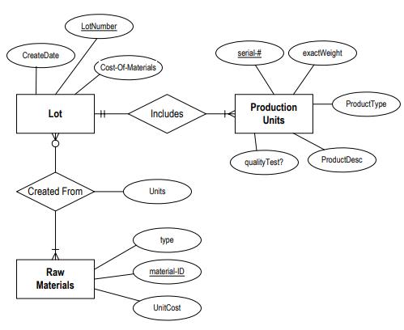
Convert ERM to ER Database
Production tracking is important in many manufacturing environments (e.g., the pharmaceuticals industry, children’s toys, etc.).
The following ER diagram captures important information in the tracking of production. Specifically, the ER diagram captures relationships between production lots (or batches), individual production units, and raw materials.

Slide 5
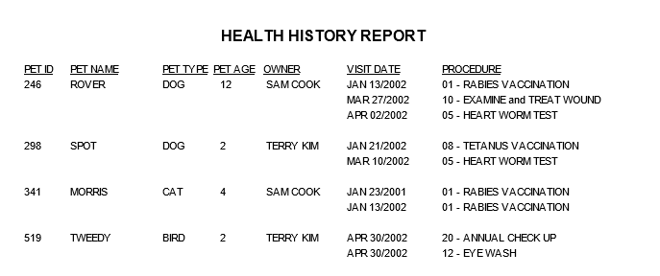
Normalization

Slide 6
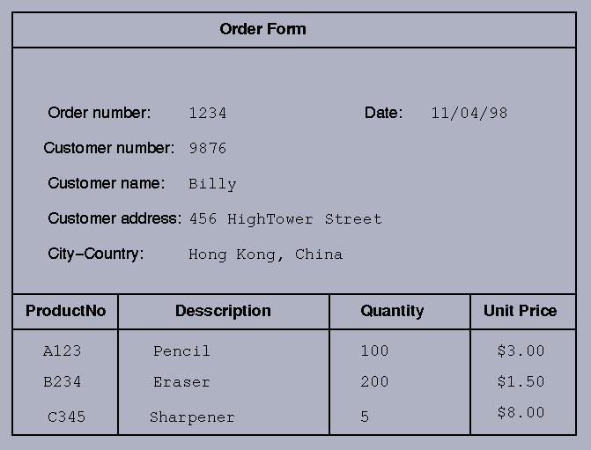
Normalization

Slide 7
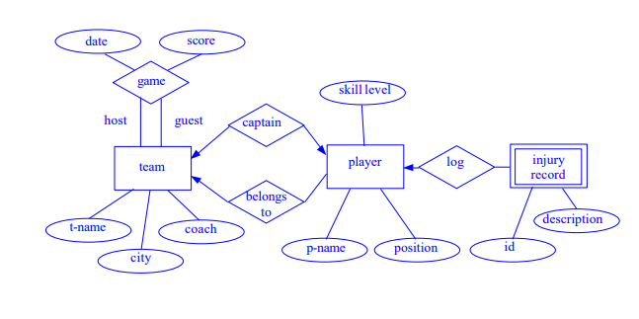
Solution 1 :

Slide 8
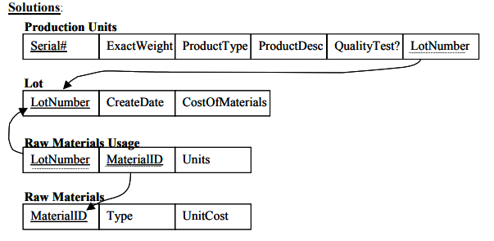
Solution 2 :

Slide 9
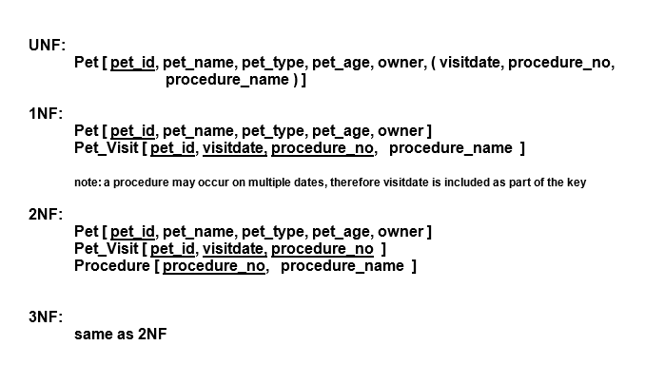
Solution 3:

Slide 10
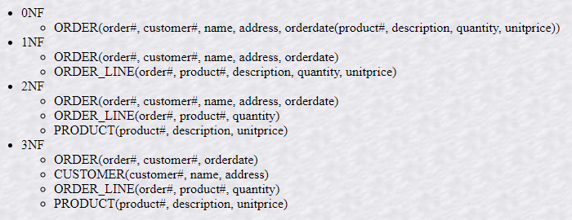
Solution 4:

Slide 11
Relational Database
Create relational database based on solution 1-4

Slide 12
Thank you

